Slide 1

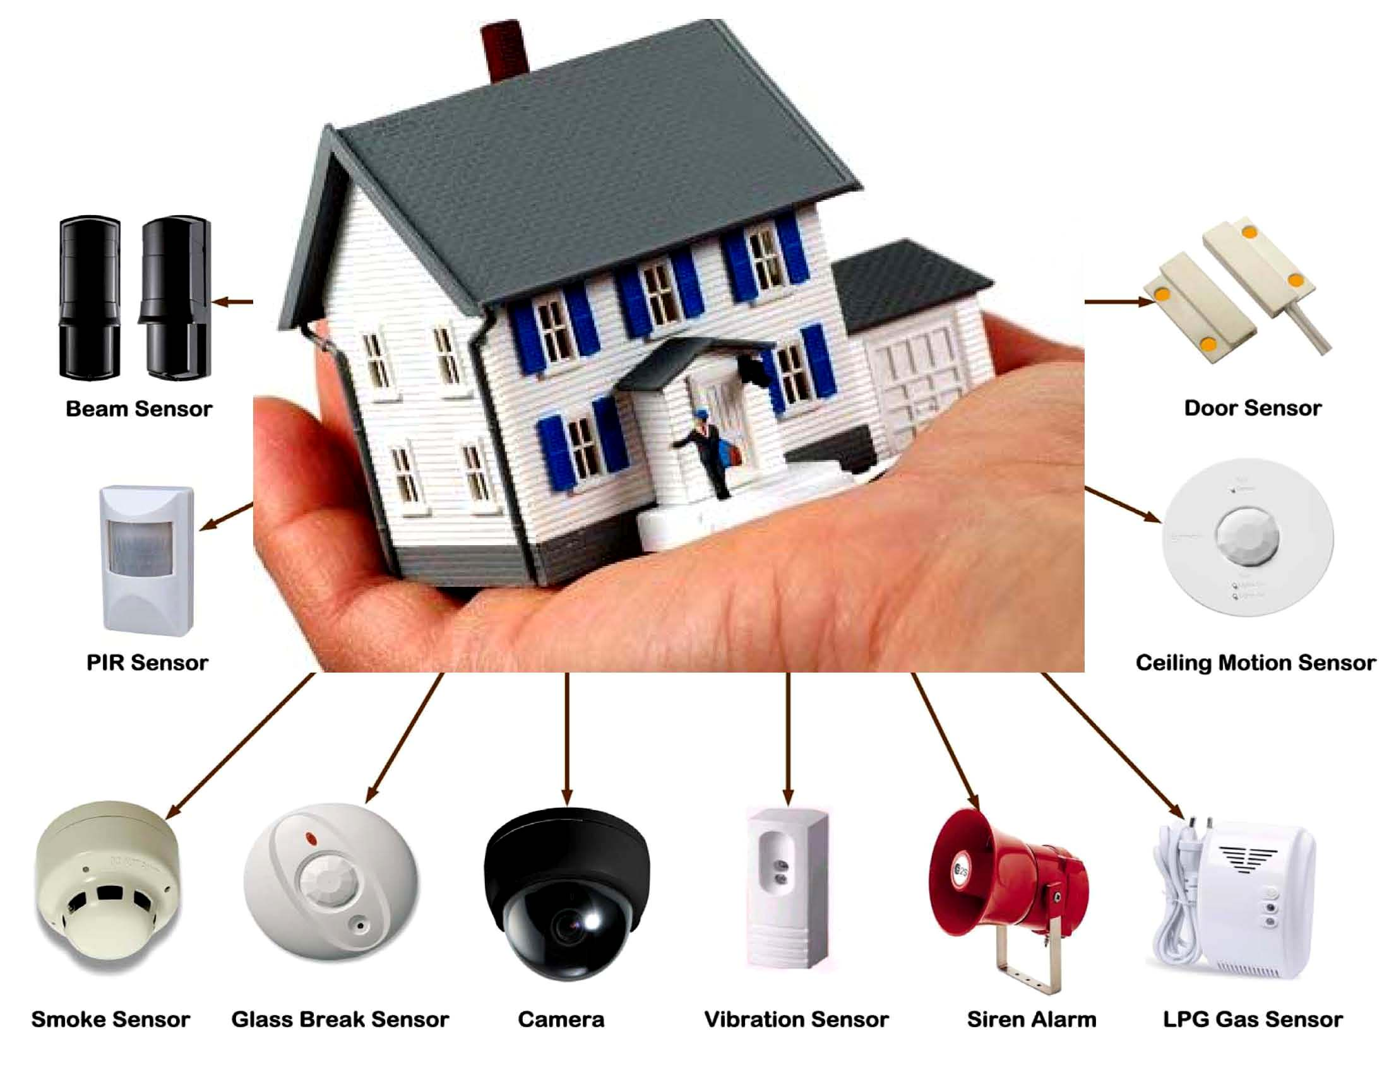

Slide 2

ZigBee 3.0 complete interoperable IoT solution

Slide 3
背景
因为安防系统的特殊性，在系统设备构成上较其他子系统有特殊要 求。这些设备在划分为 ZigBee 三种基本设备类型的基础上，还做了进一步类。具体可以分为：安防系统指示设备(IAS Control and Indicating Equipment)、安防系统辅助控制设备 (IAS Ancillary Control Equipment)、安防系统区域(IAS Zone)和安防系统区域报警设备(IAS Warning Devices)

Slide 4
What is a security system?
The most basic definition of any security system is found in its name. It is literally a means or method by which something is secured through a system of interworking components and devices.
In this instance, we’re talking about home security systems, which are networks of integrated electronic devices working together with a central control panel to protect against burglars and other potential home intruders.

Slide 5
A typical home security system
A control panel, which is the primary controller of a home’s security system
Door and window sensors
Motion sensors, both interior and exterior
Wired or wireless security cameras
A high-decibel siren or alarm
A yard sign and window stickers

Slide 6
How does a security system work?
Home security systems work on the simple concept of securing entry points into a home with sensors that communicate with a control panel or command center installed in a convenient location somewhere in the home.
The sensors are typically placed in doors that lead to and from a house as well as easily accessible windows, particularly any that open, especially those at ground level. Open spaces inside of homes can be secured with motion sensors.

Slide 7
Control Panel
The control panel is the computer that arms and disarms the security systems, communicates with each installed component, sounds the alarm when a security zone is breached, and communicates with an alarm monitoring company.

Slide 8
Door and Window Sensors
Door and Window Sensors are comprised of two parts installed adjacent to each other. One part of the device is installed on the door or window and the other on the door frame or window sill. When a door or window is closed, the two parts of the sensor are joined together, creating a security circuit.
When the security system is armed at the control panel, these sensors communicate with it by reporting that the point of entry is secure. Should a monitored door or window suddenly be opened, the security circuit is broken and the control panel interprets this as a breach of a secured zone. A high-decibel alarm is sounded and in most instances the alarm monitoring company is automatically notified.

Slide 9
Motion Sensors
These security components, when armed, protect a given space by creating an invisible zone that cannot be breached without sounding an alarm. These are typically used to protect rooms containing valuables, as well as areas less frequented in larger homes.

Slide 10
Surveillance Cameras
Available in both wired and wireless configurations, surveillance cameras can be used in several different ways as part of an overall security system.
Typical uses include monitoring:
Hard to see or distant areas of your property
Remote buildings like garages, barns, and workshops
Entry points, both exterior and interior, like garage doors and front doors

Slide 11
Surveillance cameras can be accessed remotely on computers, smartphones, and tablets. They are often used in this method when homeowners are out of town, to watch for deliveries and other service personnel like caregivers and landscapers, and to monitor the arrival of children after school. They can also be used to record any security breaches, which could result in having footage of a home invasion, including a good look at the burglars and perhaps even the vehicle they drove.

Slide 12
High-decibel Alarm
Loud enough for neighbors to hear, home security alarms serve a few different purposes. First, they alert the people inside the house that a problem occurred. They’re also shrill enough to send a burglar running while also notifying nearby neighbors to the situation.

Slide 13
Yard Sign and Window Stickers
On the surface, these items might seem like nothing more than marketing tools for alarm companies, but they play important roles in home security. When you place a security company’s sticker in a front window and plant their sign in your front yard, you are telling burglars you home is professionally protected and not a wise choice for an attempted burglary. They are effective at conveying this message and should be used as recommended by the security company.

Slide 14
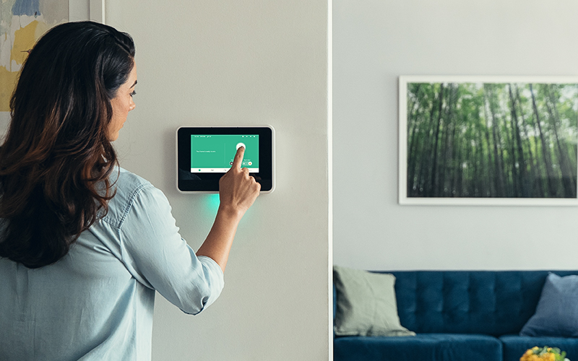
What Happens when an intrusion occurs?

Slide 15
Security systems are designed to perform certain tasks when a secured zone is breached. What your security systems does in the event of an intrusion depends on the type of system you’re using.
Professionally Monitored Security Systems
If your security system is professionally monitored by an alarm company, they are alerted when a security problem arises in your home. Along with the high-decibel alarm that sounds, the monitoring company is alerted. A trained security expert might attempt to communicate with the homeowner via the control panel if it’s setup for 2-Way Voice communication, or will call the emergency contact number listed on the account.

Slide 16
These types of security systems communicate with the monitoring company in one of several ways, including:
Over existing home phone lines, which continue to work during power outages when battery backup is in use.
Wirelessly through cellular radio frequencies like cell phones use, which also continue to work during power outages when battery backup is in use.
Voice over Internet Protocol (VoIP), which typically doesn’t work in a power outage.
Via the Internet, which also typically does not work in a power outage.

Slide 17
Over existing home phone lines, which continue to work during power outages when battery backup is in use.
Wirelessly through cellular radio frequencies like cell phones use, which also continue to work during power outages when battery backup is in use.
Voice over Internet Protocol (VoIP), which typically doesn’t work in a power outage.
Via the Internet, which also typically does not work in a power outage.

Slide 18
Non-monitored Security Systems
There are plenty of DIY security systems available today that don’t include professionally monitored services. In the event of a home intrusion when this type of security system is installed, a high-decibel alarm sounds (provided one is installed). Contacting police, fire, or other emergency response personnel must be initiated by the homeowner by dialing the appropriate number, typically 911.

Slide 19
安防领域设备分类
IAS Control and Indicating Equipment
IAS Ancillary Control Equipment
IAS Zone
IAS Warning Devices

Slide 20
安防系统控制指示设备(IAS CIE)
IAS CIE 是安防警报系统的中央控制器和指示设备。它辅助接收传感器(Zones)发出的信号 并控制设备(ACE)，同时还向报警设备(WD)发送信号。它是整个安防系统的大脑是安防设 备不可或缺的一部分，一个 ZigBee 安防系统必须拥有至少一个或以上的具备 IAS CIE 功能 的设备。一般情况下，IAS CIE 功能集成在 ZigBee Coordinator 协调器中。

Slide 21
安防系统辅助控制设备(IAS ACE)
IAS ACE 是安防报警系统的遥控装置。在取得相应权限的情况下，附带 ACE 功能的 ZigBee 设备能够访问 IAS CIE 设备并控制 IAS 系统。常见的IAS ACE 设备有遥控器、开关等 等。

Slide 22
安防系统区域(IAS Zone)
IAS Zone 设备能够探测某个区域的报警条件，并给 CIE 设备发送信号。IAS Zone 设备支 持二种报警模式：低电量报告和安防系统报告。常见的IAS Zone 设备有动作探测器、烟感 器等、门磁、水浸。

Slide 23
安防报警系统区域报警设备(IAS WD)
当 IAS CIE的报警条件被触发，IAS 报警设备能够发出音频或可视的报警指示(警报声、 闪光灯等)。常见的 IAS WD 设备有声光报警器等。

Slide 24
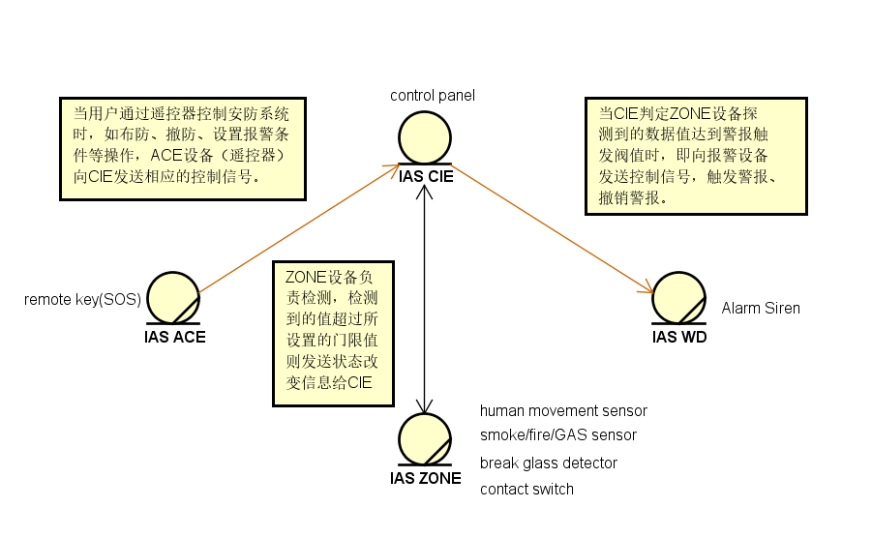
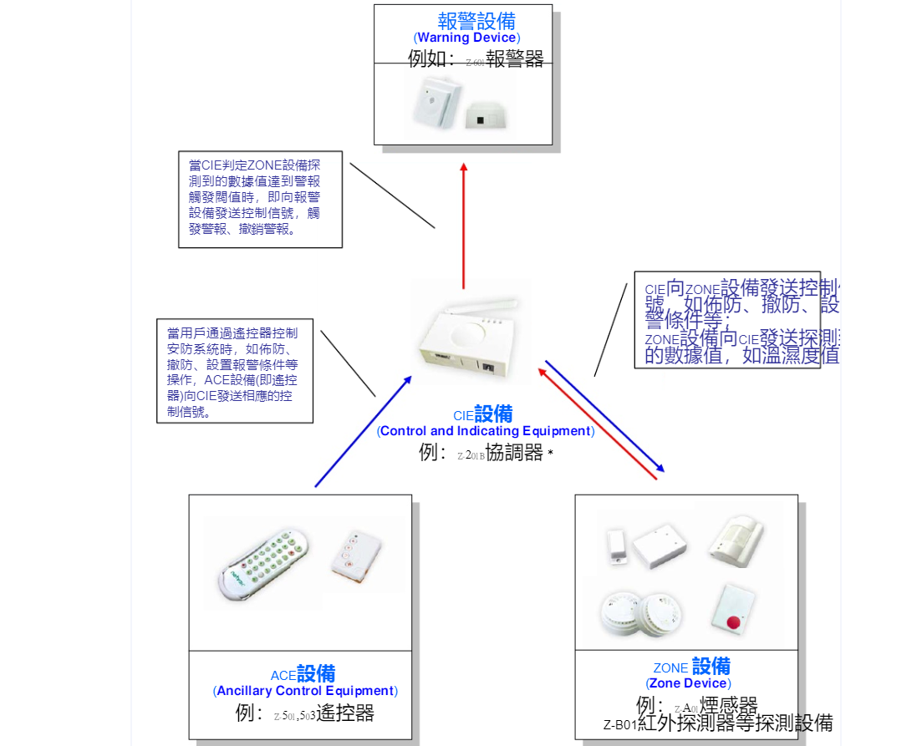
应用案例

Slide 25
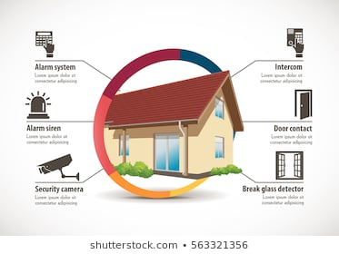

Slide 26
